Slide 1
CSCI 330
THE UNIX SYSTEM
Regular Expressions
Notes:
CSCI 330 - The UNIX System
NIU - Department of Computer Science

Slide 2
REGULAR EXPRESSION
A pattern of special characters used to match strings in a search
Typically made up from special characters called metacharacters
Regular expressions are used thoughout UNIX:
  Editors: ed, ex, vi
  Utilities: grep, egrep, sed, and awk
CSCI 330 - The UNIX System

Slide 3
METACHARACTERS
any non-metacharacter matches itself
RE Metacharacter | Matches…
. | Any one character, except new line
[a-z] | Any one of the enclosed characters (e.g. a-z)
* | Zero or more of preceding character
? or \? | Zero or one of the preceding characters
+ or \+ | One or more of the preceding characters
CSCI 330 - The UNIX System

Slide 4
THE GREP UTILITY
“grep” command:
searches for text in file(s)
Examples:
% grep root mail.log
% grep r..t mail.log
% grep ro*t mail.log
% grep ‘ro*t’ mail.log
% grep ‘r[a-z]*t’ mail.log
CSCI 330 - The UNIX System

Slide 5
MORE METACHARACTERS
RE Metacharacter | Matches…
^ | beginning of line
$ | end of line
\char | Escape the meaning of char following it
[^] | One character not in the set
\< | Beginning of word anchor
\> | End of word anchor
( ) or \( \) | Tags matched characters to be used later (max = 9)
| or \| | Or grouping
x\{m\} | Repetition of character x, m times (x,m = integer)
x\{m,\} | Repetition of character x, at least m times
x\{m,n\} | Repetition of character x between m and m times
CSCI 330 - The UNIX System

Slide 6
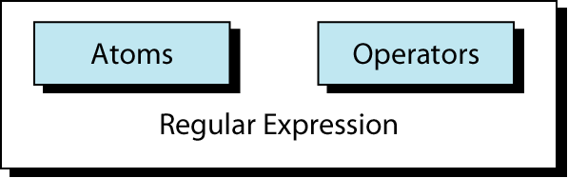
Regular Expression
An atom specifies what text is to be matched and where it is to be found.
An operator combines regular expression atoms.
CSCI 330 - The UNIX System

Slide 7
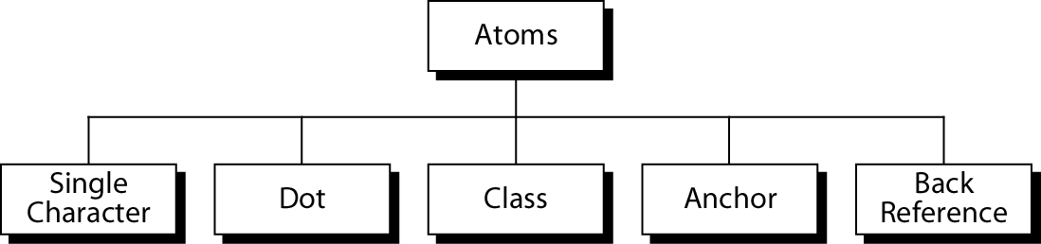
Atoms
An atom specifies what text is to be matched and where
it is to be found.
CSCI 330 - The UNIX System

Slide 8
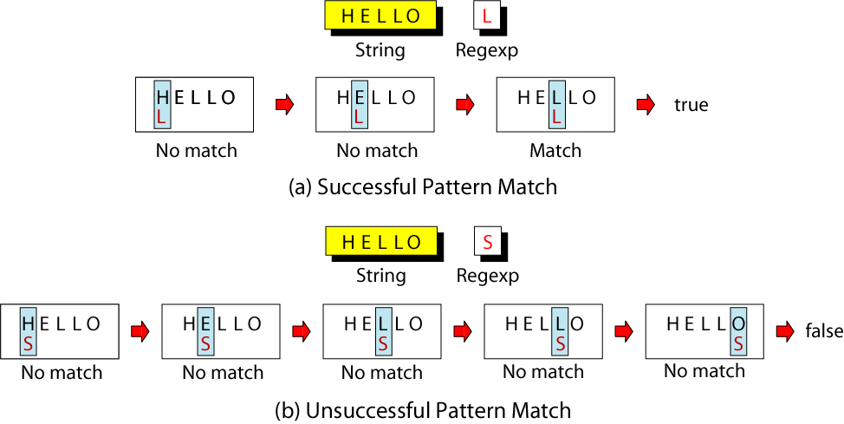
Single-Character Atom
A single character matches itself
CSCI 330 - The UNIX System

Slide 9
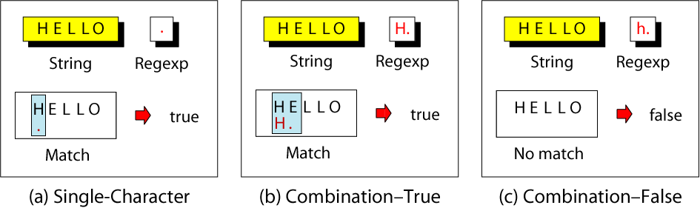
Dot Atom
matches any single character except for a new
line character (\n)
CSCI 330 - The UNIX System

Slide 10
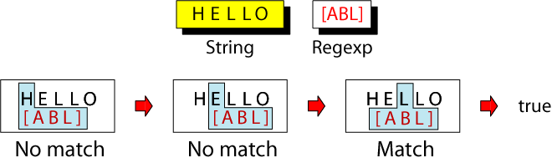
Class Atom
matches only single character that can be any of
the characters defined in a set:
Example: [ABC] matches either A, B, or C.
CSCI 330 - The UNIX System
Notes:
1) A range of characters is indicated by a dash, e.g. [A-Q]
2) Can specify characters to be excluded from the set, e.g.
[^0-9] matches any character other than a number.

Slide 11
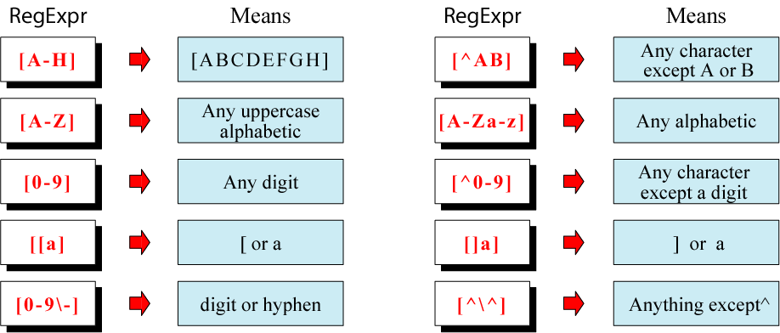
Example: Classes
CSCI 330 - The UNIX System

Slide 12
SHORT-HAND CLASSES
[:alnum:]
[:alpha:]
[:upper:]
[:lower:]
[:digit:]
[:space:]
CSCI 330 - The UNIX System

Slide 13
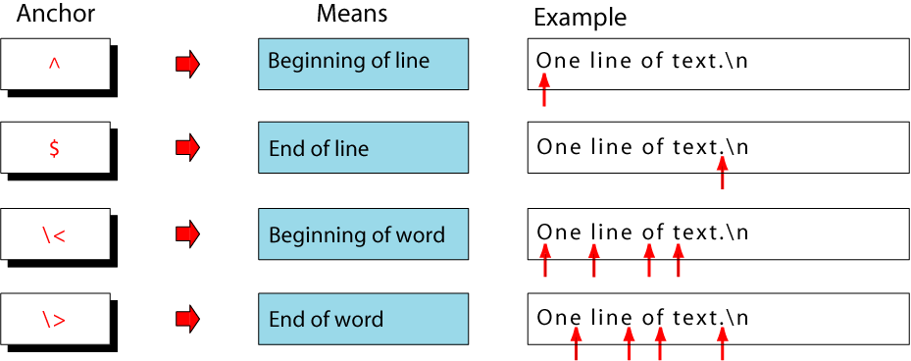
Anchors
Anchors tell where the next character in the pattern must
be located in the text data.
CSCI 330 - The UNIX System

Slide 14
BACK REFERENCES: \N
used to retrieve saved text in one of nine buffers
can refer to the text in a saved buffer by using a back reference:
ex.: \1 \2 \3 ...\9
more details on this later
CSCI 330 - The UNIX System

Slide 15
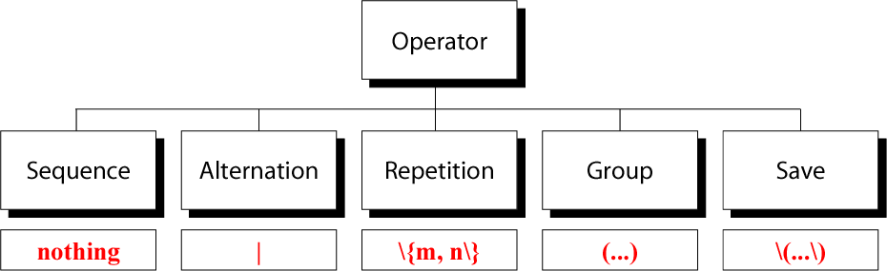
Operators
CSCI 330 - The UNIX System

Slide 16
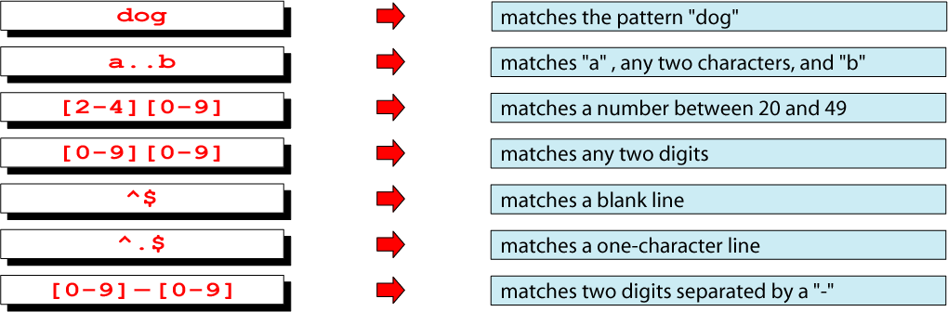
Sequence Operator
In a sequence operator, if a series of atoms are shown in
a regular expression, there is no operator between them.
CSCI 330 - The UNIX System

Slide 17
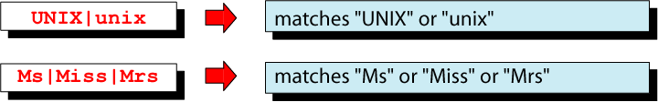
Alternation Operator: | or \|
operator (| or \| ) is used to define one
or more alternatives
CSCI 330 - The UNIX System
Note: depends on version of “grep”

Slide 18
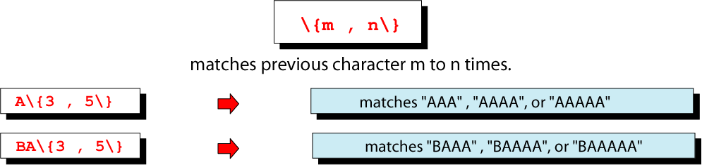
Repetition Operator: \{…\}
The repetition operator specifies that the atom or expression immediately before the repetition may be
repeated.
CSCI 330 - The UNIX System

Slide 19
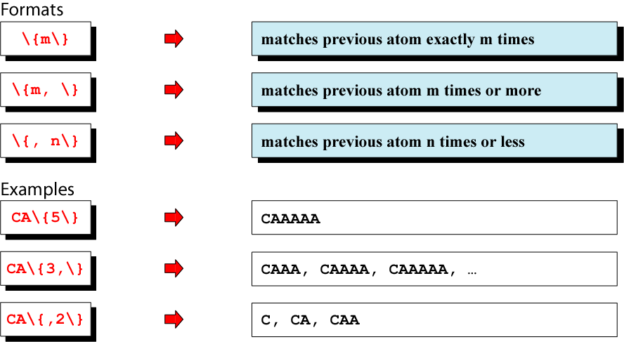
Basic Repetition Forms
CSCI 330 - The UNIX System

Slide 20
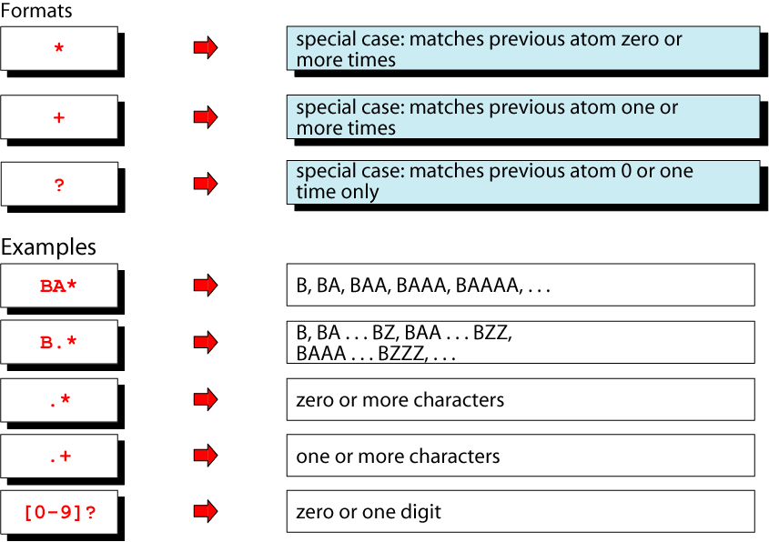
Short Form Repetition Operators: * + ?
CSCI 330 - The UNIX System

Slide 21
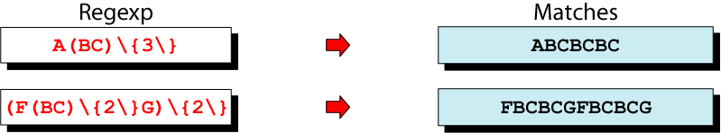
Group Operator
In the group operator, when a group of characters is
enclosed in parentheses, the next operator applies to the
whole group, not only the previous characters.
CSCI 330 - The UNIX System
Note: depends on version of “grep”
use \( and \) instead

Slide 22
GREP DETAIL AND EXAMPLES
grep is family of commands
  grep
  common version
  egrep
  understands extended REs
  (| + ? ( ) don’t need backslash)
  fgrep
  understands only fixed strings, i.e. is faster
  rgrep
  will traverse sub-directories recursively
CSCI 330 - The UNIX System

Slide 23
COMMONLY USED “GREP” OPTIONS:
-c | Print only a count of matched lines.
-i | Ignore uppercase and lowercase distinctions.
-l | List all files that contain the specified pattern.
-n | Print matched lines and line numbers.
-s | Work silently; display nothing except error messages. Useful for checking the exit status.
-v | Print lines that do not match the pattern.
CSCI 330 - The UNIX System

Slide 24
EXAMPLE: GREP WITH PIPE
% ls -l | grep '^d'
drwxr-xr-x 2 krush csci 512 Feb 8 22:12 assignments
drwxr-xr-x 2 krush csci 512 Feb 5 07:43 feb3
drwxr-xr-x 2 krush csci 512 Feb 5 14:48 feb5
drwxr-xr-x 2 krush csci 512 Dec 18 14:29 grades
drwxr-xr-x 2 krush csci 512 Jan 18 13:41 jan13
drwxr-xr-x 2 krush csci 512 Jan 18 13:17 jan15
drwxr-xr-x 2 krush csci 512 Jan 18 13:43 jan20
drwxr-xr-x 2 krush csci 512 Jan 24 19:37 jan22
drwxr-xr-x 4 krush csci 512 Jan 30 17:00 jan27
drwxr-xr-x 2 krush csci 512 Jan 29 15:03 jan29
% ls -l | grep -c '^d'
10
Pipe the output of the “ls –l” command to grep and list/select only directory entries.
CSCI 330 - The UNIX System
Display the number of lines where the pattern was found. This does not mean the number of occurrences of the pattern.

Slide 25
EXAMPLE: GREP WITH \< \>
% cat grep-datafile
northwest NW Charles Main 300000.00
western WE Sharon Gray 53000.89
southwest SW Lewis Dalsass 290000.73
southern SO Suan Chin 54500.10
southeast SE Patricia Hemenway 400000.00
eastern EA TB Savage 440500.45
northeast NE AM Main Jr. 57800.10
north NO Ann Stephens 455000.50
central CT KRush 575500.70
Extra [A-Z]****[0-9]..$5.00
CSCI 330 - The UNIX System
Print the line if it contains the word “north”.
% grep '\<north\>' grep-datafile
north NO Ann Stephens 455000.50

Slide 26
EXAMPLE: GREP WITH A\|B
% cat grep-datafile
northwest NW Charles Main 300000.00
western WE Sharon Gray 53000.89
southwest SW Lewis Dalsass 290000.73
southern SO Suan Chin 54500.10
southeast SE Patricia Hemenway 400000.00
eastern EA TB Savage 440500.45
northeast NE AM Main Jr. 57800.10
north NO Ann Stephens 455000.50
central CT KRush 575500.70
Extra [A-Z]****[0-9]..$5.00
CSCI 330 - The UNIX System
Print the lines that contain either the expression “NW” or the expression “EA”
% grep 'NW\|EA' grep-datafile
northwest NW Charles Main 300000.00
eastern EA TB Savage 440500.45
Note: egrep works with |

Slide 27
EXAMPLE: EGREP WITH +
% cat grep-datafile
northwest NW Charles Main 300000.00
western WE Sharon Gray 53000.89
southwest SW Lewis Dalsass 290000.73
southern SO Suan Chin 54500.10
southeast SE Patricia Hemenway 400000.00
eastern EA TB Savage 440500.45
northeast NE AM Main Jr. 57800.10
north NO Ann Stephens 455000.50
central CT KRush 575500.70
Extra [A-Z]****[0-9]..$5.00
CSCI 330 - The UNIX System
Print all lines containing one or more 3's.
% egrep '3+' grep-datafile
northwest NW Charles Main 300000.00
western WE Sharon Gray 53000.89
southwest SW Lewis Dalsass 290000.73
Note: grep works with \+

Slide 28
EXAMPLE: EGREP WITH RE: ?
% cat grep-datafile
northwest NW Charles Main 300000.00
western WE Sharon Gray 53000.89
southwest SW Lewis Dalsass 290000.73
southern SO Suan Chin 54500.10
southeast SE Patricia Hemenway 400000.00
eastern EA TB Savage 440500.45
northeast NE AM Main Jr. 57800.10
north NO Ann Stephens 455000.50
central CT KRush 575500.70
Extra [A-Z]****[0-9]..$5.00
CSCI 330 - The UNIX System
Print all lines containing a 2, followed by zero or one period, followed by a number.
% egrep '2\.?[0-9]' grep-datafile
southwest SW Lewis Dalsass 290000.73
Note: grep works with \?

Slide 29
EXAMPLE: EGREP WITH ( )
% cat grep-datafile
northwest NW Charles Main 300000.00
western WE Sharon Gray 53000.89
southwest SW Lewis Dalsass 290000.73
southern SO Suan Chin 54500.10
southeast SE Patricia Hemenway 400000.00
eastern EA TB Savage 440500.45
northeast NE AM Main Jr. 57800.10
north NO Ann Stephens 455000.50
central CT KRush 575500.70
Extra [A-Z]****[0-9]..$5.00
CSCI 330 - The UNIX System
Print all lines containing one or more consecutive occurrences of the pattern “no”.
% egrep '(no)+' grep-datafile
northwest NW Charles Main 300000.00
northeast NE AM Main Jr. 57800.10
north NO Ann Stephens 455000.50
Note: grep works with \( \) \+

Slide 30
EXAMPLE: EGREP WITH (A|B)
% cat grep-datafile
northwest NW Charles Main 300000.00
western WE Sharon Gray 53000.89
southwest SW Lewis Dalsass 290000.73
southern SO Suan Chin 54500.10
southeast SE Patricia Hemenway 400000.00
eastern EA TB Savage 440500.45
northeast NE AM Main Jr. 57800.10
north NO Ann Stephens 455000.50
central CT KRush 575500.70
Extra [A-Z]****[0-9]..$5.00
CSCI 330 - The UNIX System
Print all lines containing the uppercase letter “S”, followed by either “h” or “u”.
% egrep 'S(h|u)' grep-datafile
western WE Sharon Gray 53000.89
southern SO Suan Chin 54500.10
Note: grep works with \( \) \|

Slide 31
EXAMPLE: FGREP
% cat grep-datafile
northwest NW Charles Main 300000.00
western WE Sharon Gray 53000.89
southwest SW Lewis Dalsass 290000.73
southern SO Suan Chin 54500.10
southeast SE Patricia Hemenway 400000.00
eastern EA TB Savage 440500.45
northeast NE AM Main Jr. 57800.10
north NO Ann Stephens 455000.50
central CT KRush 575500.70
Extra [A-Z]****[0-9]..$5.00
CSCI 330 - The UNIX System
Find all lines in the file containing the literal string “[A-Z]****[0-9]..$5.00”. All characters are treated as themselves. There are no special characters.
% fgrep '[A-Z]****[0-9]..$5.00' grep-datafile
Extra [A-Z]****[0-9]..$5.00

Slide 32
EXAMPLE: GREP WITH ^
% cat grep-datafile
northwest NW Charles Main 300000.00
western WE Sharon Gray 53000.89
southwest SW Lewis Dalsass 290000.73
southern SO Suan Chin 54500.10
southeast SE Patricia Hemenway 400000.00
eastern EA TB Savage 440500.45
northeast NE AM Main Jr. 57800.10
north NO Ann Stephens 455000.50
central CT KRush 575500.70
Extra [A-Z]****[0-9]..$5.00
CSCI 330 - The UNIX System
Print all lines beginning with the letter n.
% grep '^n' grep-datafile
northwest NW Charles Main 300000.00
northeast NE AM Main Jr. 57800.10
north NO Ann Stephens 455000.50

Slide 33
EXAMPLE: GREP WITH $
% cat grep-datafile
northwest NW Charles Main 300000.00
western WE Sharon Gray 53000.89
southwest SW Lewis Dalsass 290000.73
southern SO Suan Chin 54500.10
southeast SE Patricia Hemenway 400000.00
eastern EA TB Savage 440500.45
northeast NE AM Main Jr. 57800.10
north NO Ann Stephens 455000.50
central CT KRush 575500.70
Extra [A-Z]****[0-9]..$5.00
CSCI 330 - The UNIX System
Print all lines ending with a period and exactly two zero numbers.
% grep '\.00$' grep-datafile
northwest NW Charles Main 300000.00
southeast SE Patricia Hemenway 400000.00
Extra [A-Z]****[0-9]..$5.00

Slide 34
EXAMPLE: GREP WITH \CHAR
% cat grep-datafile
northwest NW Charles Main 300000.00
western WE Sharon Gray 53000.89
southwest SW Lewis Dalsass 290000.73
southern SO Suan Chin 54500.10
southeast SE Patricia Hemenway 400000.00
eastern EA TB Savage 440500.45
northeast NE AM Main Jr. 57800.10
north NO Ann Stephens 455000.50
central CT KRush 575500.70
Extra [A-Z]****[0-9]..$5.00
CSCI 330 - The UNIX System
Print all lines containing the number 5, followed by a literal period and any single character.
% grep '5\..' grep-datafile
Extra [A-Z]****[0-9]..$5.00

Slide 35
EXAMPLE: GREP WITH [ ]
% cat grep-datafile
northwest NW Charles Main 300000.00
western WE Sharon Gray 53000.89
southwest SW Lewis Dalsass 290000.73
southern SO Suan Chin 54500.10
southeast SE Patricia Hemenway 400000.00
eastern EA TB Savage 440500.45
northeast NE AM Main Jr. 57800.10
north NO Ann Stephens 455000.50
central CT KRush 575500.70
Extra [A-Z]****[0-9]..$5.00
CSCI 330 - The UNIX System
Print all lines beginning with either a “w” or an “e”.
% grep '^[we]' grep-datafile
western WE Sharon Gray 53000.89
eastern EA TB Savage 440500.45

Slide 36
EXAMPLE: GREP WITH [^]
% cat grep-datafile
northwest NW Charles Main 300000.00
western WE Sharon Gray 53000.89
southwest SW Lewis Dalsass 290000.73
southern SO Suan Chin 54500.10
southeast SE Patricia Hemenway 400000.00
eastern EA TB Savage 440500.45
northeast NE AM Main Jr. 57800.10
north NO Ann Stephens 455000.50
central CT KRush 575500.70
Extra [A-Z]****[0-9]..$5.00
CSCI 330 - The UNIX System
Print all lines ending with a period and exactly two non-zero numbers.
% grep '\.[^0][^0]$' grep-datafile
western WE Sharon Gray 53000.89
southwest SW Lewis Dalsass 290000.73
eastern EA TB Savage 440500.45

Slide 37
EXAMPLE: GREP WITH X\{M\}
% cat grep-datafile
northwest NW Charles Main 300000.00
western WE Sharon Gray 53000.89
southwest SW Lewis Dalsass 290000.73
southern SO Suan Chin 54500.10
southeast SE Patricia Hemenway 400000.00
eastern EA TB Savage 440500.45
northeast NE AM Main Jr. 57800.10
north NO Ann Stephens 455000.50
central CT KRush 575500.70
Extra [A-Z]****[0-9]..$5.00
CSCI 330 - The UNIX System
Print all lines where there are at least six consecutive numbers followed by a period.
% grep '[0-9]\{6\}\.' grep-datafile
northwest NW Charles Main 300000.00
southwest SW Lewis Dalsass 290000.73
southeast SE Patricia Hemenway 400000.00
eastern EA TB Savage 440500.45
north NO Ann Stephens 455000.50
central CT KRush 575500.70

Slide 38
EXAMPLE: GREP WITH \<
% cat grep-datafile
northwest NW Charles Main 300000.00
western WE Sharon Gray 53000.89
southwest SW Lewis Dalsass 290000.73
southern SO Suan Chin 54500.10
southeast SE Patricia Hemenway 400000.00
eastern EA TB Savage 440500.45
northeast NE AM Main Jr. 57800.10
north NO Ann Stephens 455000.50
central CT KRush 575500.70
Extra [A-Z]****[0-9]..$5.00
CSCI 330 - The UNIX System
Print all lines containing a word starting with “north”.
% grep '\<north' grep-datafile
northwest NW Charles Main 300000.00
northeast NE AM Main Jr. 57800.10
north NO Ann Stephens 455000.50

Slide 39
SUMMARY
regular expressions
for grep family of commands
CSCI 330 - The UNIX System

